Slide 1
Hallucinations
Speaker : Nikhil shah
Notes:
--- This presentation explores the phenomenon of hallucinations in artificial intelligence and machine learning. We will discuss their implications, causes, and potential mitigation strategies, while also addressing ethical considerations in future developments.

Slide 2
Agenda Items
Introduction to Hallucinations in AI
Causes of Hallucinations in AI and ML Models
Hallucinations in Large Language Models (LLMs)
Mitigation Strategies for AI Hallucinations
Future Directions and Ethical Considerations
Notes:
We will begin by defining hallucinations in AI, exploring their historical context and significance. Next, we will analyze the causes behind these hallucinations in AI and ML models. Then, we will focus on hallucinations specific to large language models, followed by mitigation strategies. Finally, we will discuss future directions and ethical considerations.

Slide 3
Introduction to Hallucinations in AI
Notes:
Hallucinations in AI refer to instances where models generate outputs that are nonsensical or misleading. Understanding this phenomenon is crucial as it highlights the limitations of current AI technologies.

Slide 4
Definition and Types of Hallucinations
Types of Hallucinations
Hallucinations can be categorized into various types, including factual inaccuracies and irrelevant responses, each with unique characteristics.
Diagnosis Importance
Recognizing the various types of hallucinations is crucial for accurate diagnosis and effective treatment strategies.
Mitigation Strategies
Understanding hallucinations aids in developing strategies to mitigate their occurrence, enhancing patient care and outcomes.
Notes:
Hallucinations can be classified into different types, such as factual inaccuracies, irrelevant responses, or completely fabricated information. Recognizing these types helps in diagnosing and mitigating their occurrence.

Slide 5

Historical Context and Examples
AI Hallucinations Overview
Hallucinations in AI refer to instances where generated content deviates from reality, impacting trustworthiness.
Examples in Image Generation
Image generation models have produced unrealistic visuals, highlighting the unpredictability of AI outputs.
Text-Based Model Hallucinations
Text-based models can generate coherent yet factually incorrect statements, showcasing risks in automated communication.
Notes:
Historically, hallucinations have been observed in various AI applications, from image generation to text-based models. Examples illustrate the range of hallucinations AI can produce, revealing their potential risks.

Slide 6
Importance of Addressing Hallucinations
Reliability of AI Systems
Ensuring the reliability of AI systems is crucial for their effective deployment in various applications, particularly in critical sectors.
Consequences of Hallucinations
Failure to address hallucinations in AI can result in serious consequences, particularly in areas like healthcare and finance, where accuracy is paramount.
Trustworthiness in AI
Trustworthiness in AI is essential for user adoption and confidence, particularly in sectors that directly impact human lives.
Notes:
Addressing hallucinations is vital for the reliability and trustworthiness of AI systems. Failure to do so may lead to significant consequences in real-world applications, especially in critical fields like healthcare and finance.

Slide 7
Causes of Hallucinations in AI and ML Models
Notes:
Several factors contribute to hallucinations in AI and machine learning models. By understanding these causes, we can better target our efforts for improvement.

Slide 8

Data Quality and Biases
Impact of Data Quality
Poor data quality can significantly affect model performance, leading to unreliable outputs and erroneous conclusions.
Bias in Training Data
Biases in training data can result in skewed model behavior, perpetuating stereotypes and inaccuracies.
Hallucinations in AI Models
Hallucinations occur when models generate incorrect or fabricated information based on flawed data.
Notes:
Poor data quality and biases in training data can lead to hallucinations. If the data contains inaccuracies or is biased, the model can learn and propagate these errors in its output.

Slide 9

Model Complexity and Overfitting
Risk of Overfitting
Complex models often fit noise in the training data, leading to poor generalization and irrelevant outputs.
Simplifying Models
Simplifying models can help improve their performance and reduce the likelihood of overfitting.
Notes:
Complex models are prone to overfitting, which can cause them to generate irrelevant or nonsensical outputs. Simplifying models may help reduce this risk.

Slide 10

Training Methods and Validation Issues
Impact of Inadequate Training
Inadequate training methods can lead to unintended consequences, such as hallucinations in AI systems, affecting their reliability.
Need for Robust Validation
Insufficient validation can allow errors to propagate, making it crucial to implement thorough validation procedures for AI models.
Mitigation Strategies
Implementing effective training and validation protocols can substantially reduce the risk of hallucinations in AI systems.
Notes:
Inadequate training methods and insufficient validation can lead to hallucinations. It's essential to implement robust training and validation protocols to mitigate this risk.

Slide 11
Hallucinations in Large Language Models (LLMs)
Notes:
Large language models, while powerful, are particularly susceptible to hallucinations. Exploring their mechanisms offers insights into how to address this issue.

Slide 12
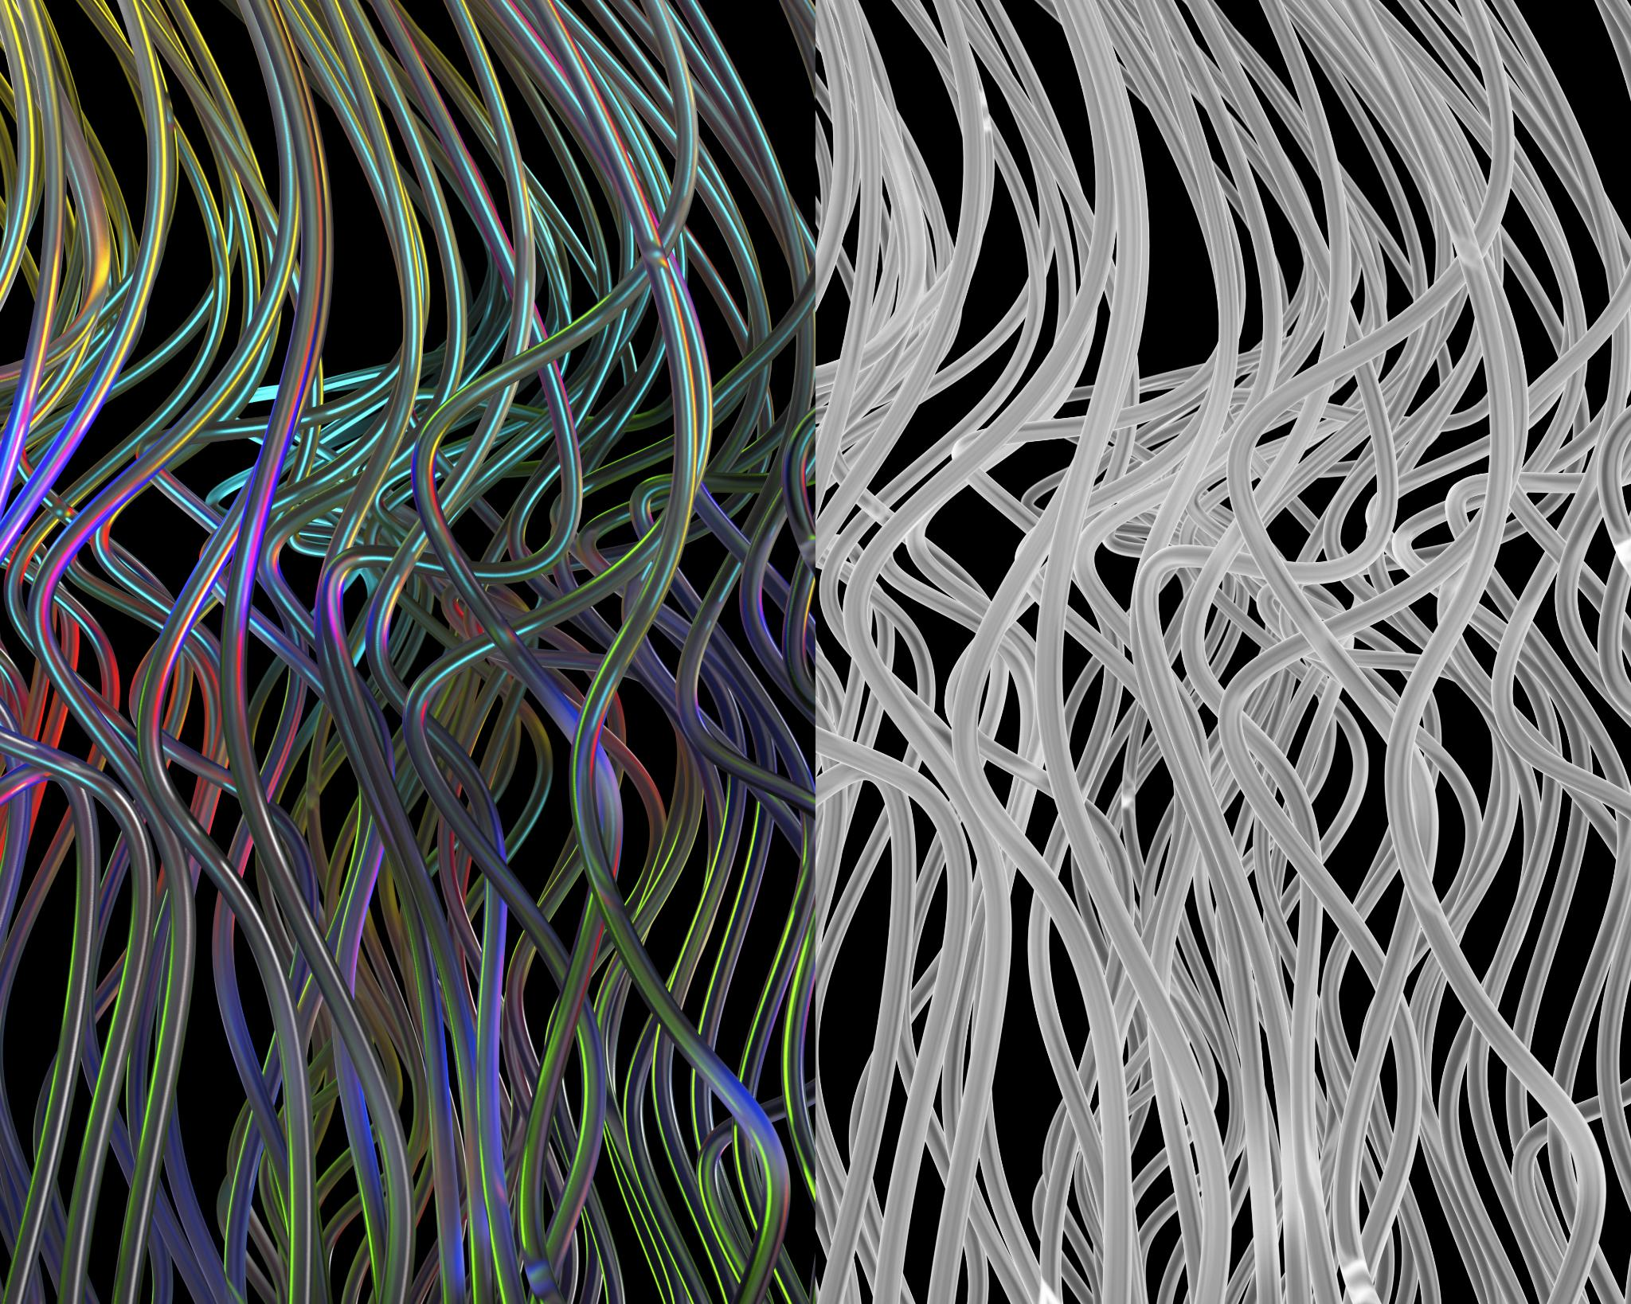
Mechanisms of Hallucinations in LLMs
Data Pattern Reliance
LLMs depend on recognizing patterns in data, which can lead to incorrect outputs or hallucinations.
Factual Understanding Limitations
The lack of true understanding of facts contributes to the generation of hallucinated content in LLMs.
Developing Solutions
Understanding the mechanisms of hallucinations is crucial for developing effective solutions to mitigate them in LLMs.
Notes:
LLMs can generate hallucinations due to their reliance on patterns in data rather than factual understanding. This limitation must be understood to develop effective solutions.

Slide 13
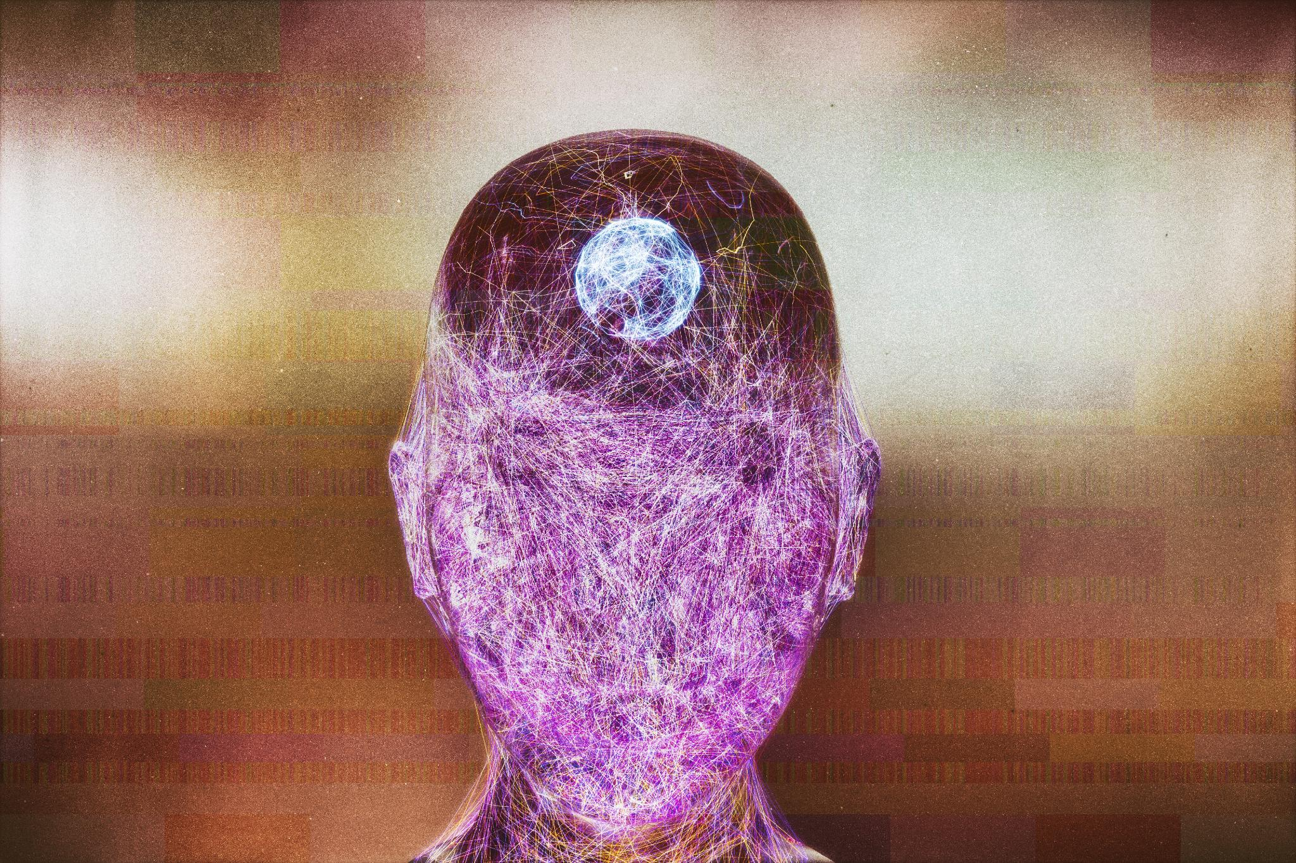
Case Studies and Examples
Understanding Hallucinations
Hallucinations in LLMs refer to the generation of inaccurate or nonsensical outputs, showcasing their limitations in understanding context.
Case Study Insights
Various case studies provide insights into how hallucinations can manifest in real-world applications, leading to unpredictable outcomes.
Consequences of Hallucinations
The potential consequences of hallucinations in LLMs can impact decision-making and trust in AI systems across various sectors.
Notes:
Several case studies illustrate the occurrence of hallucinations in LLMs, demonstrating their unpredictability and potential consequences in practical applications.

Slide 14

Consequences of LLM Hallucinations
Misinformation Risk
Hallucinations in LLMs can lead to the spread of misinformation, which can misguide users and create confusion.
User Interaction Misunderstandings
Misunderstandings during user interactions can arise from hallucinations, diminishing trust in AI systems and their outputs.
Responsible AI Deployment
Addressing hallucinations is critical for the responsible deployment of AI technologies, ensuring they serve users effectively.
Notes:
The consequences of hallucinations in LLMs can be significant, ranging from misinformation to misunderstandings in user interactions. Addressing these is critical for responsible AI deployment.

Slide 15
Mitigation Strategies for AI Hallucinations
Notes:
To effectively address hallucinations, various strategies can be implemented. These include improving data quality, enhancing model interpretability, and employing advanced validation techniques.

Slide 16

Improving Data Quality and Preprocessing
Importance of Data Quality
High-quality training data is crucial for building reliable models and reducing the risk of hallucinations.
Preprocessing Techniques
Effective preprocessing techniques help clean and transform data, ensuring it is suitable for model training.
Reducing Hallucinations
By enhancing data quality and preprocessing, we can significantly reduce hallucinations in AI models.
Notes:
Enhancing the quality of training data and employing effective preprocessing techniques are essential steps in reducing hallucinations and increasing model reliability.

Slide 17

Enhancing Model Interpretability
Understanding AI Hallucinations
Enhancing interpretability helps developers identify and understand the causes of AI model hallucinations.
Reliable Outputs
Improved model interpretability leads to more reliable outputs, making AI systems trustworthy and efficient.
Rectifying Issues
Understanding the reasons behind model decisions allows for timely rectification of errors and biases.
Notes:
Improving the interpretability of AI models allows developers to understand and rectify the reasons behind hallucinations, fostering more reliable outputs.

Slide 18

Advanced Validation and Testing Techniques
Importance of Validation
Advanced validation techniques are crucial in identifying issues in AI systems prior to deployment, enhancing reliability.
Addressing Hallucinations
Identifying potential hallucinations ensures that AI systems provide accurate and reliable outcomes, improving user trust.
Robust Testing Methodologies
Implementing advanced testing methodologies leads to stronger AI systems and reduces the risk of failure.
Notes:
Implementing advanced validation and testing methodologies can help identify and address potential hallucinations before deployment, ensuring AI systems are more robust.

Slide 19
Future Directions and Ethical Considerations
Notes:
As AI continues to evolve, future research must prioritize addressing hallucinations and their ethical implications. Understanding these considerations is crucial for responsible innovation.

Slide 20

Future Research and Development
Resilient AI Systems
Research should prioritize the development of AI systems that are resilient and robust against errors and hallucinations.
Managing Hallucinations
Future studies must focus on techniques to effectively manage and reduce hallucinations in AI systems, promoting accuracy and reliability.
Safer Applications
Ensuring safety in AI applications across various domains is paramount, requiring dedicated research efforts to prevent potential risks.
Notes:
Future research should focus on developing more resilient AI systems that can effectively manage and reduce hallucinations, ensuring safer applications in various domains.

Slide 21
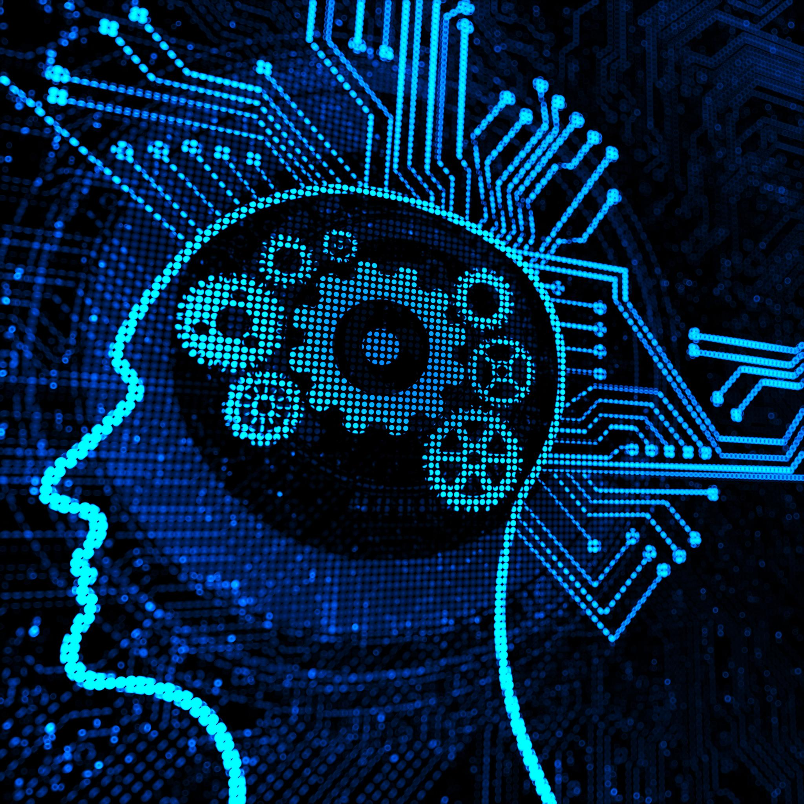
Ethical Implications and Responsibilities
Understanding AI Hallucinations
AI hallucinations can lead to misinformation and misunderstandings, emphasizing the need for ethical considerations in AI development.
Developer Responsibilities
Developers must prioritize ethical standards to create AI systems that minimize risks and enhance user trust.
Promoting Trust in AI
Organizations should implement practices that ensure transparency and reliability in AI systems to foster public trust.
Notes:
The ethical implications of AI hallucinations must be considered. Developers and organizations have a responsibility to create AI systems that minimize risks and promote trust.

Slide 22

Community and Collaborative Efforts
Collective Effort
Addressing AI hallucinations requires a collaborative approach among various stakeholders to ensure comprehensive solutions.
Research Collaboration
Collaboration between researchers can lead to innovative methods for addressing AI challenges, enhancing understanding and outcomes.
Policymaker Engagement
Involving policymakers in discussions helps create guidelines that promote responsible AI development and deployment.
Notes:
Addressing hallucinations in AI is a collective effort. Collaboration between researchers, developers, and policymakers can lead to more effective solutions and guidelines.

Slide 23
Conclusion
Importance of Understanding Hallucinations
Understanding hallucinations in AI is essential for developing reliable and trustworthy machine learning systems.
Causes and Implications
Exploring the causes and implications of AI hallucinations helps in devising better strategies to mitigate their impact.
Mitigation Strategies
Implementation of effective mitigation strategies is crucial for the responsible deployment of AI technologies.
Notes:
In conclusion, understanding and addressing hallucinations in AI and machine learning is essential for building reliable systems. By exploring their causes, implications, and mitigation strategies, we can pave the way for responsible and effective AI deployment.

Slide 24
Thanks and Regards nikhilshah nikhilshah.net@hotmail.com 8975089722
Notes:
Large language models represent a significant leap in natural language processing capabilities, allowing for complex text generation and understanding. This section will explain what defines LLMs.

